Slide 1
Different Data for Different Insights
Jon Clifton, Managing director, Gallup global analytics

Slide 2

Egypt gdp and life evaluations
Arab Spring Begins
*In current international dollars, estimates from IMF
Copyright © 2014, 2015 Gallup, Inc. All rights reserved.
Notes:
GDP per capita (PPP) data from IMF
http://www.imf.org/external/pubs/ft/weo/2014/01/weodata/index.aspx

Slide 3
What is the Gallup world poll?
Copyright © 2014, 2015 Gallup, Inc. All rights reserved.

Slide 4
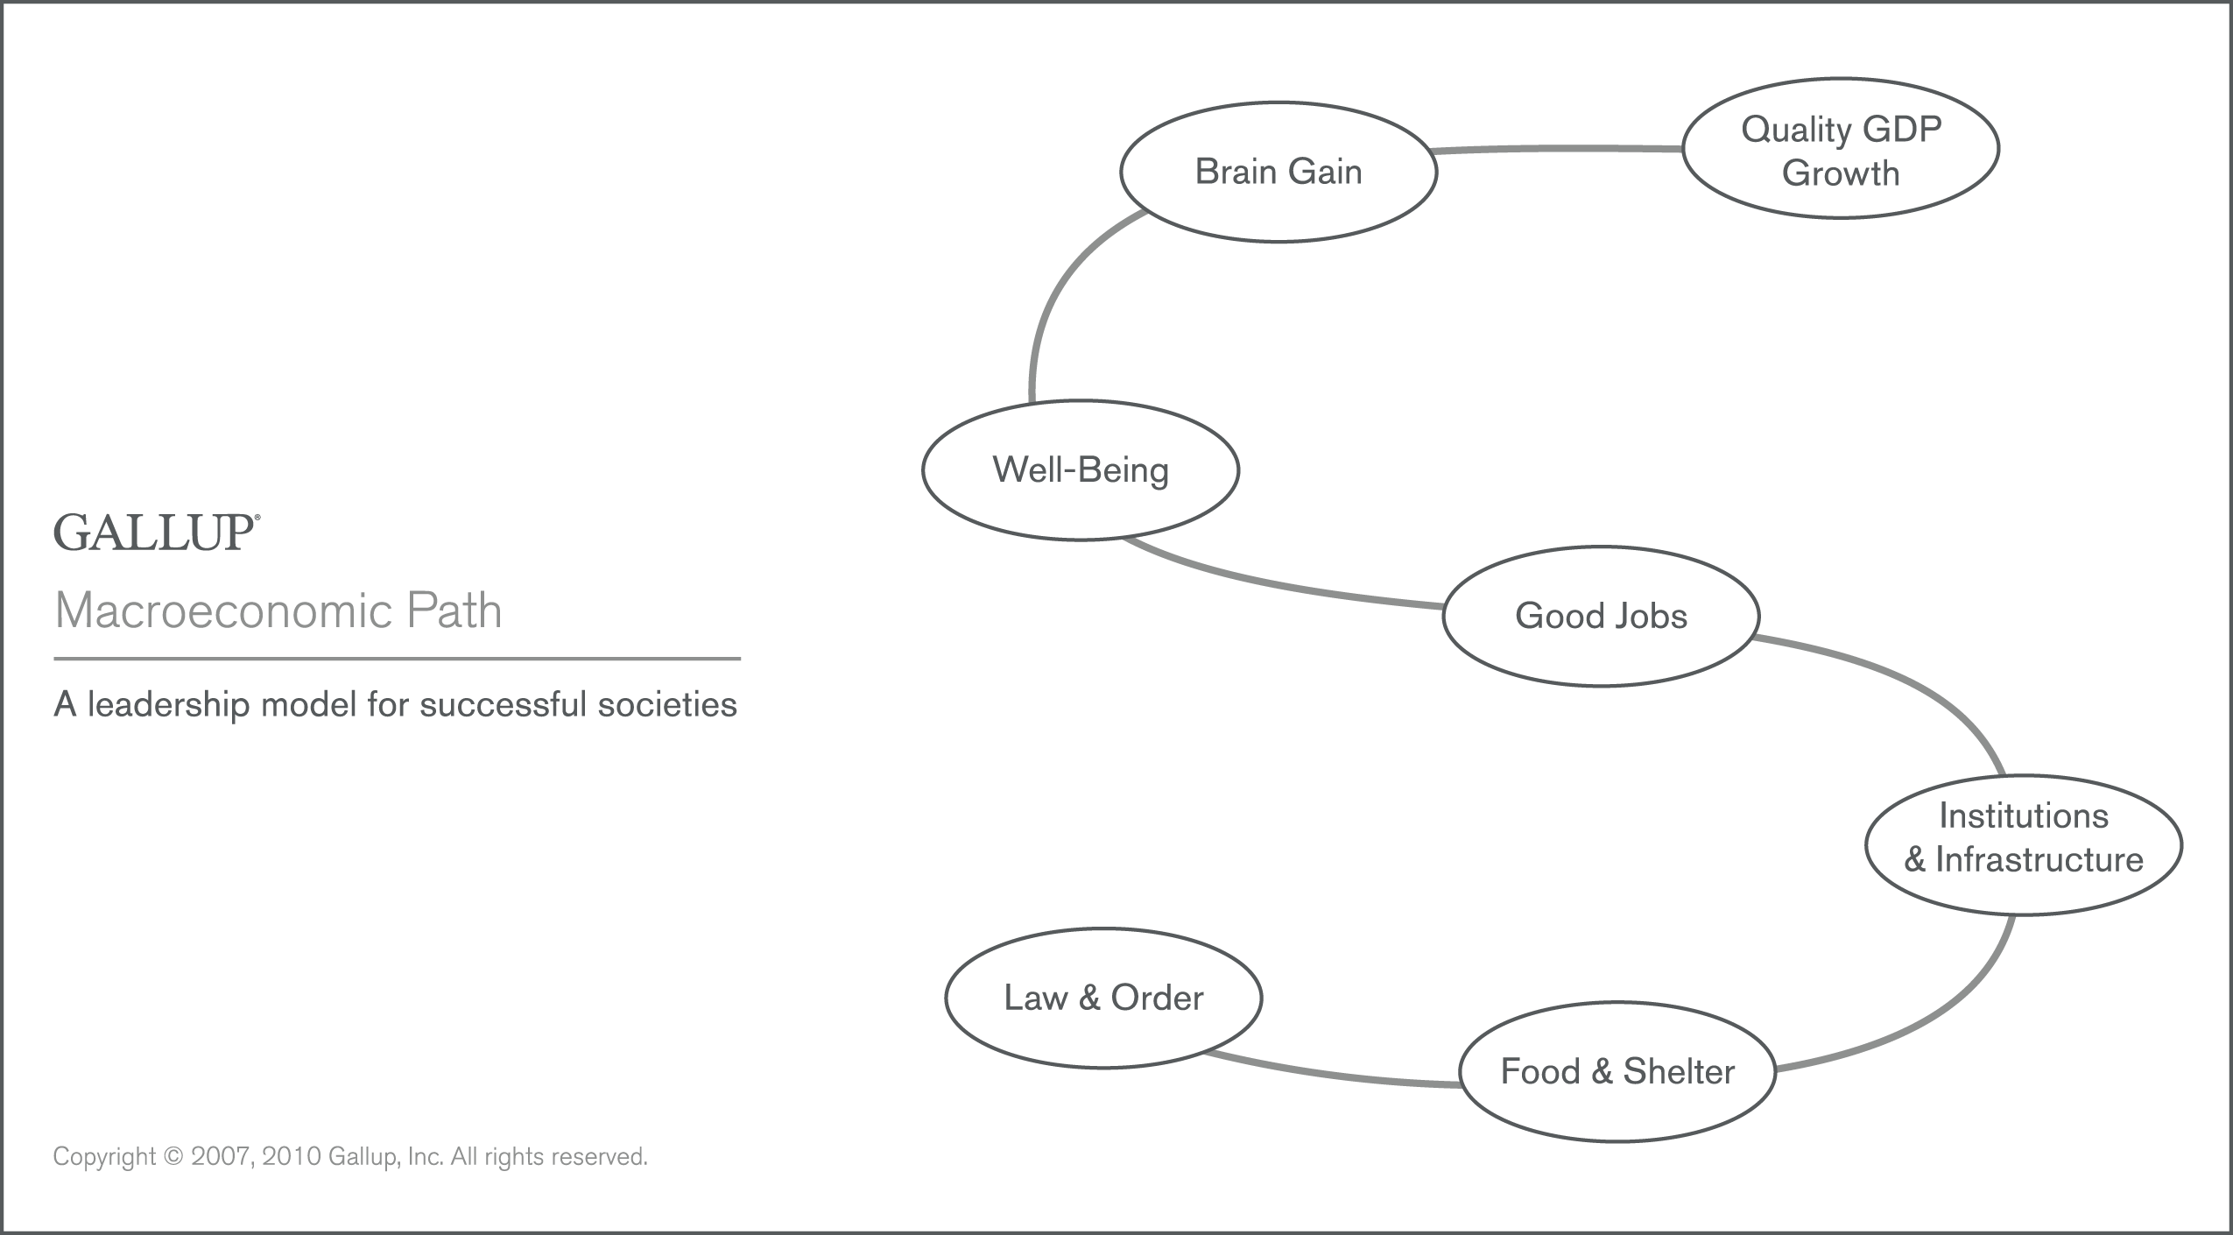
Copyright © 2007, 2014 Gallup, Inc. All rights reserved.

Slide 5
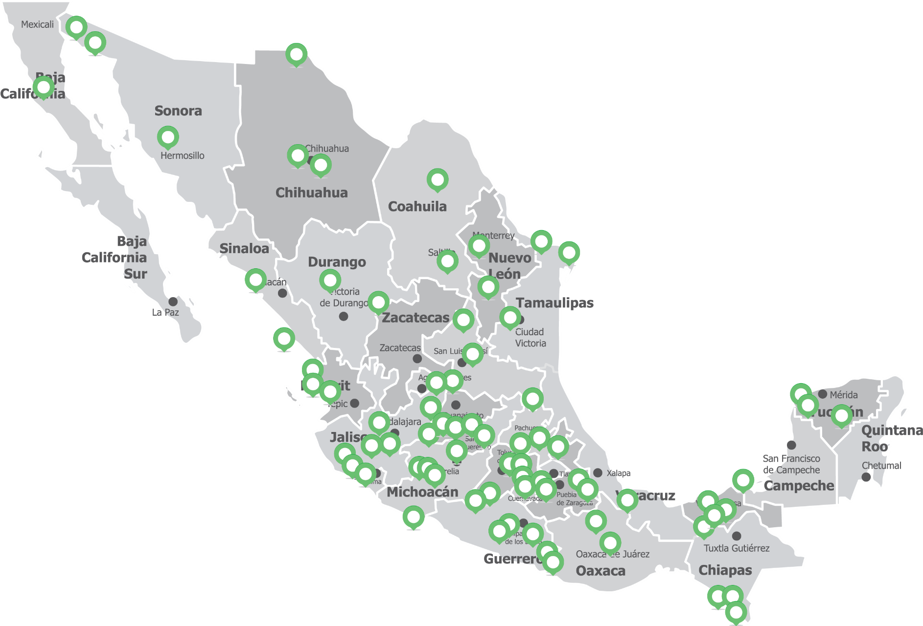
Sampling frame for Mexico
Copyright © 2015 Gallup, Inc. All rights reserved.

Slide 6
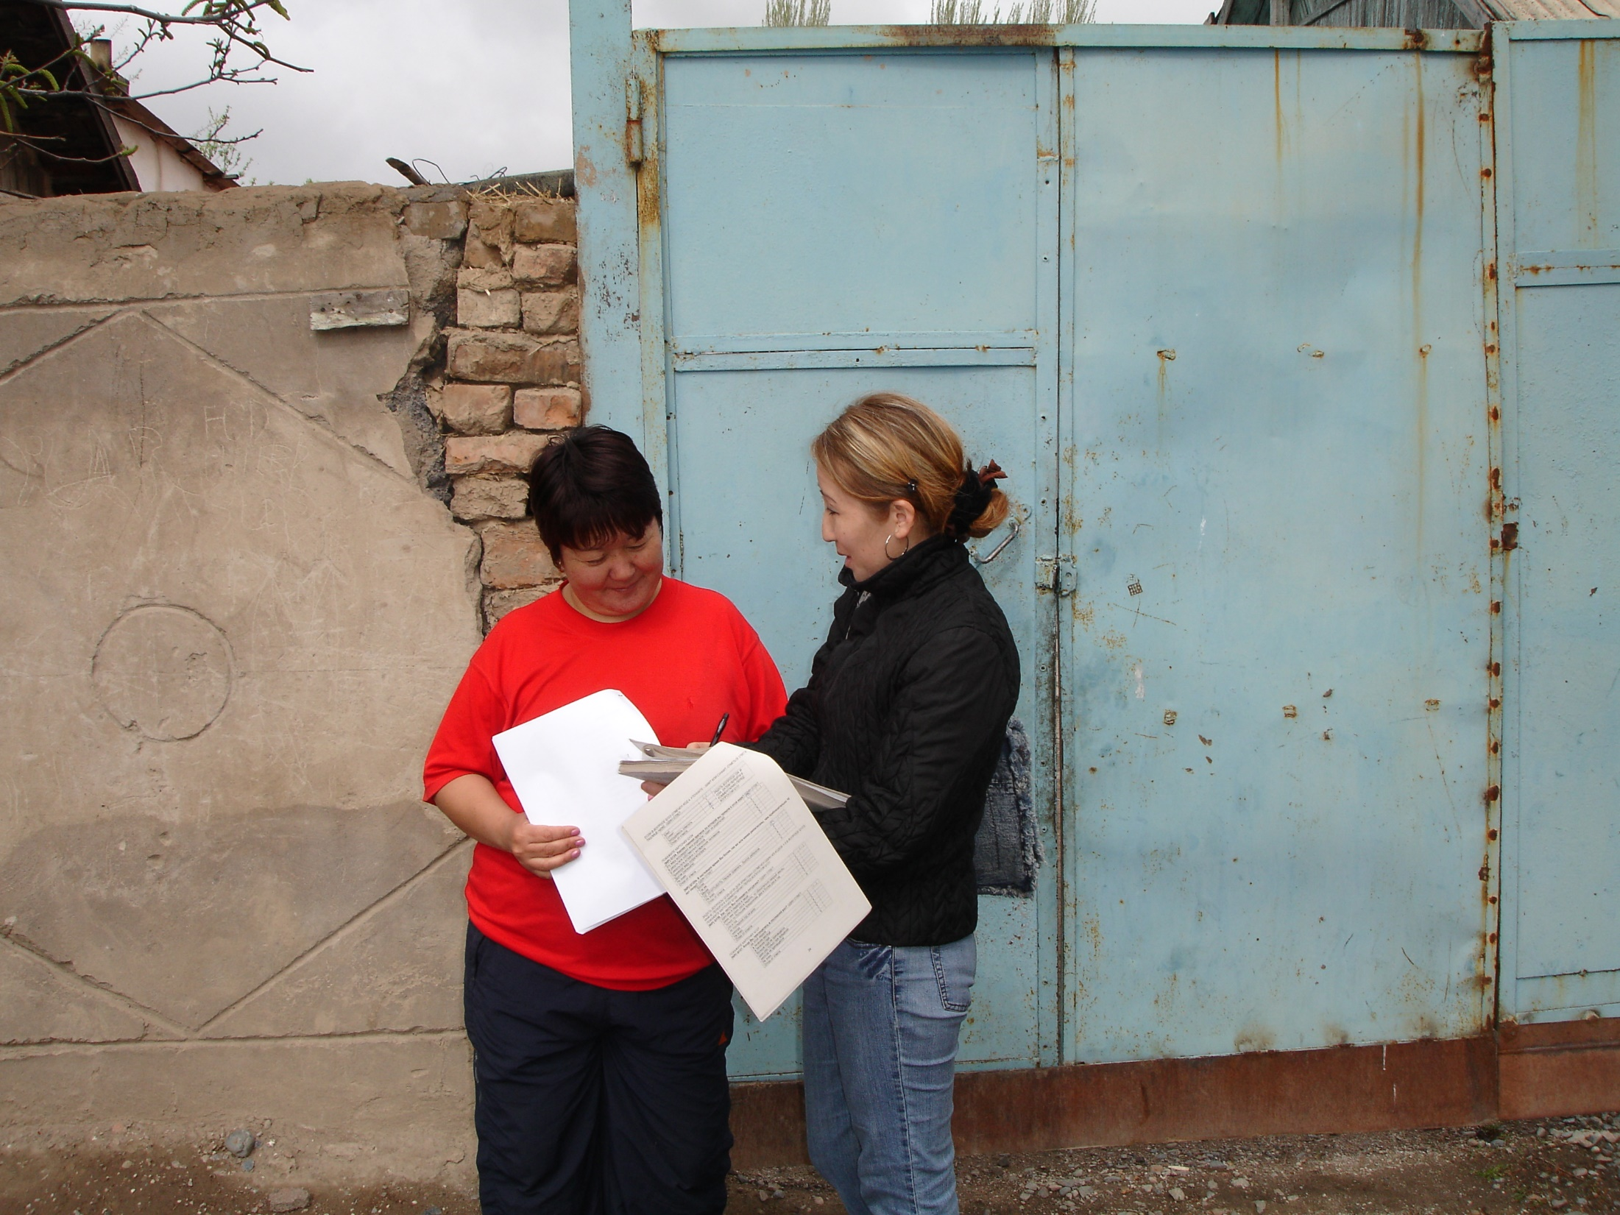
Copyright © 2014 Gallup, Inc. All rights reserved.
Notes:
Kyrzistan

Slide 7
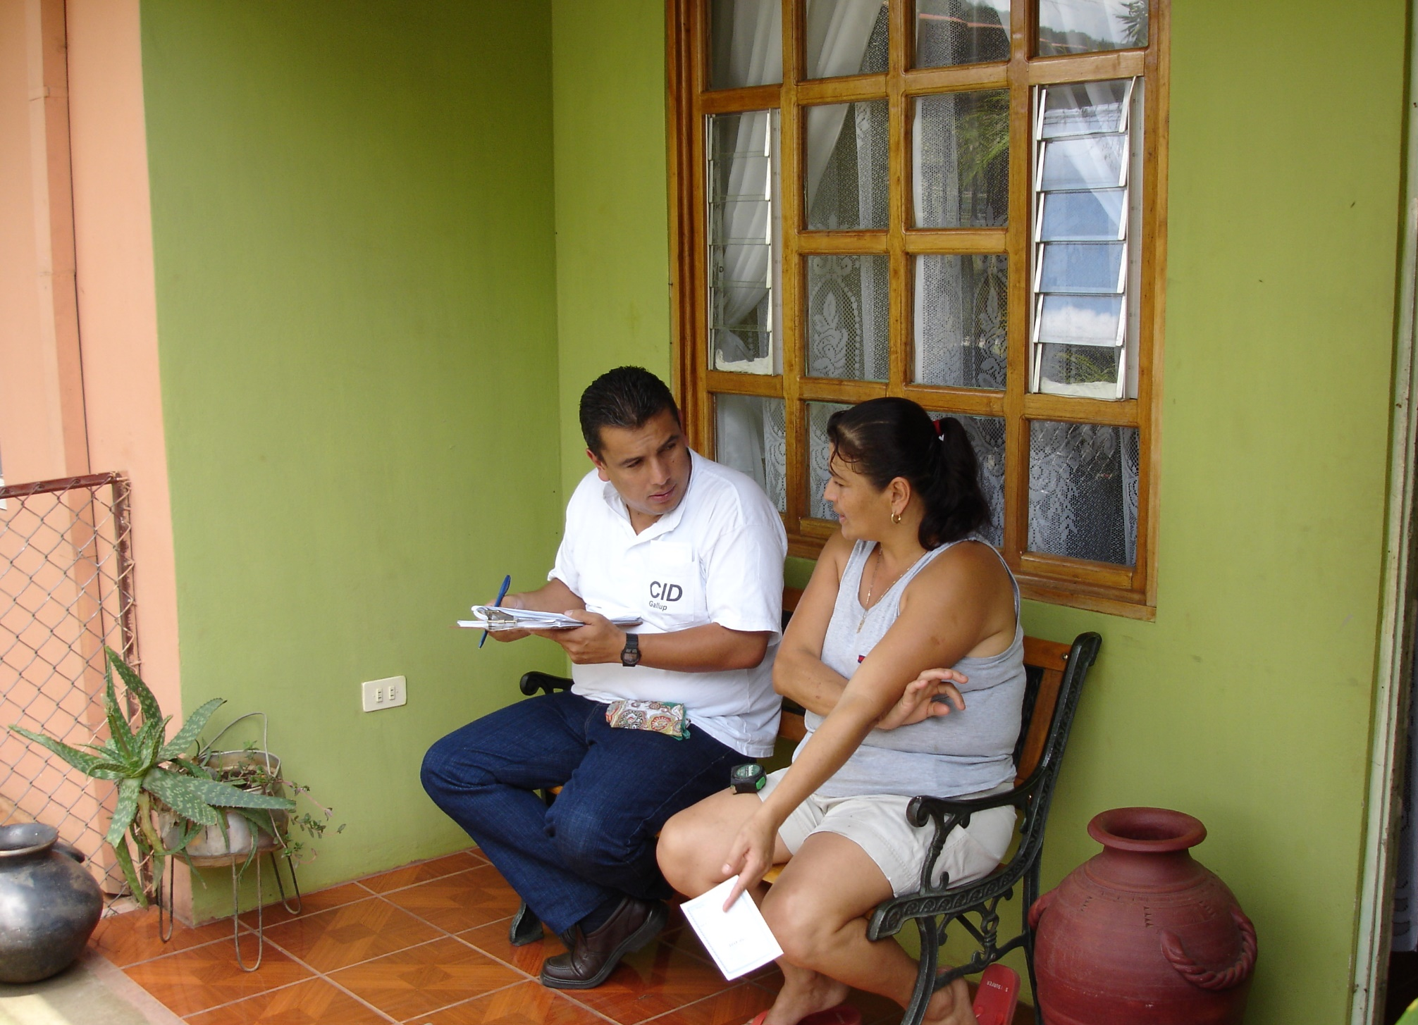
Copyright © 2014 Gallup, Inc. All rights reserved.
Notes:
Costa Rica

Slide 8
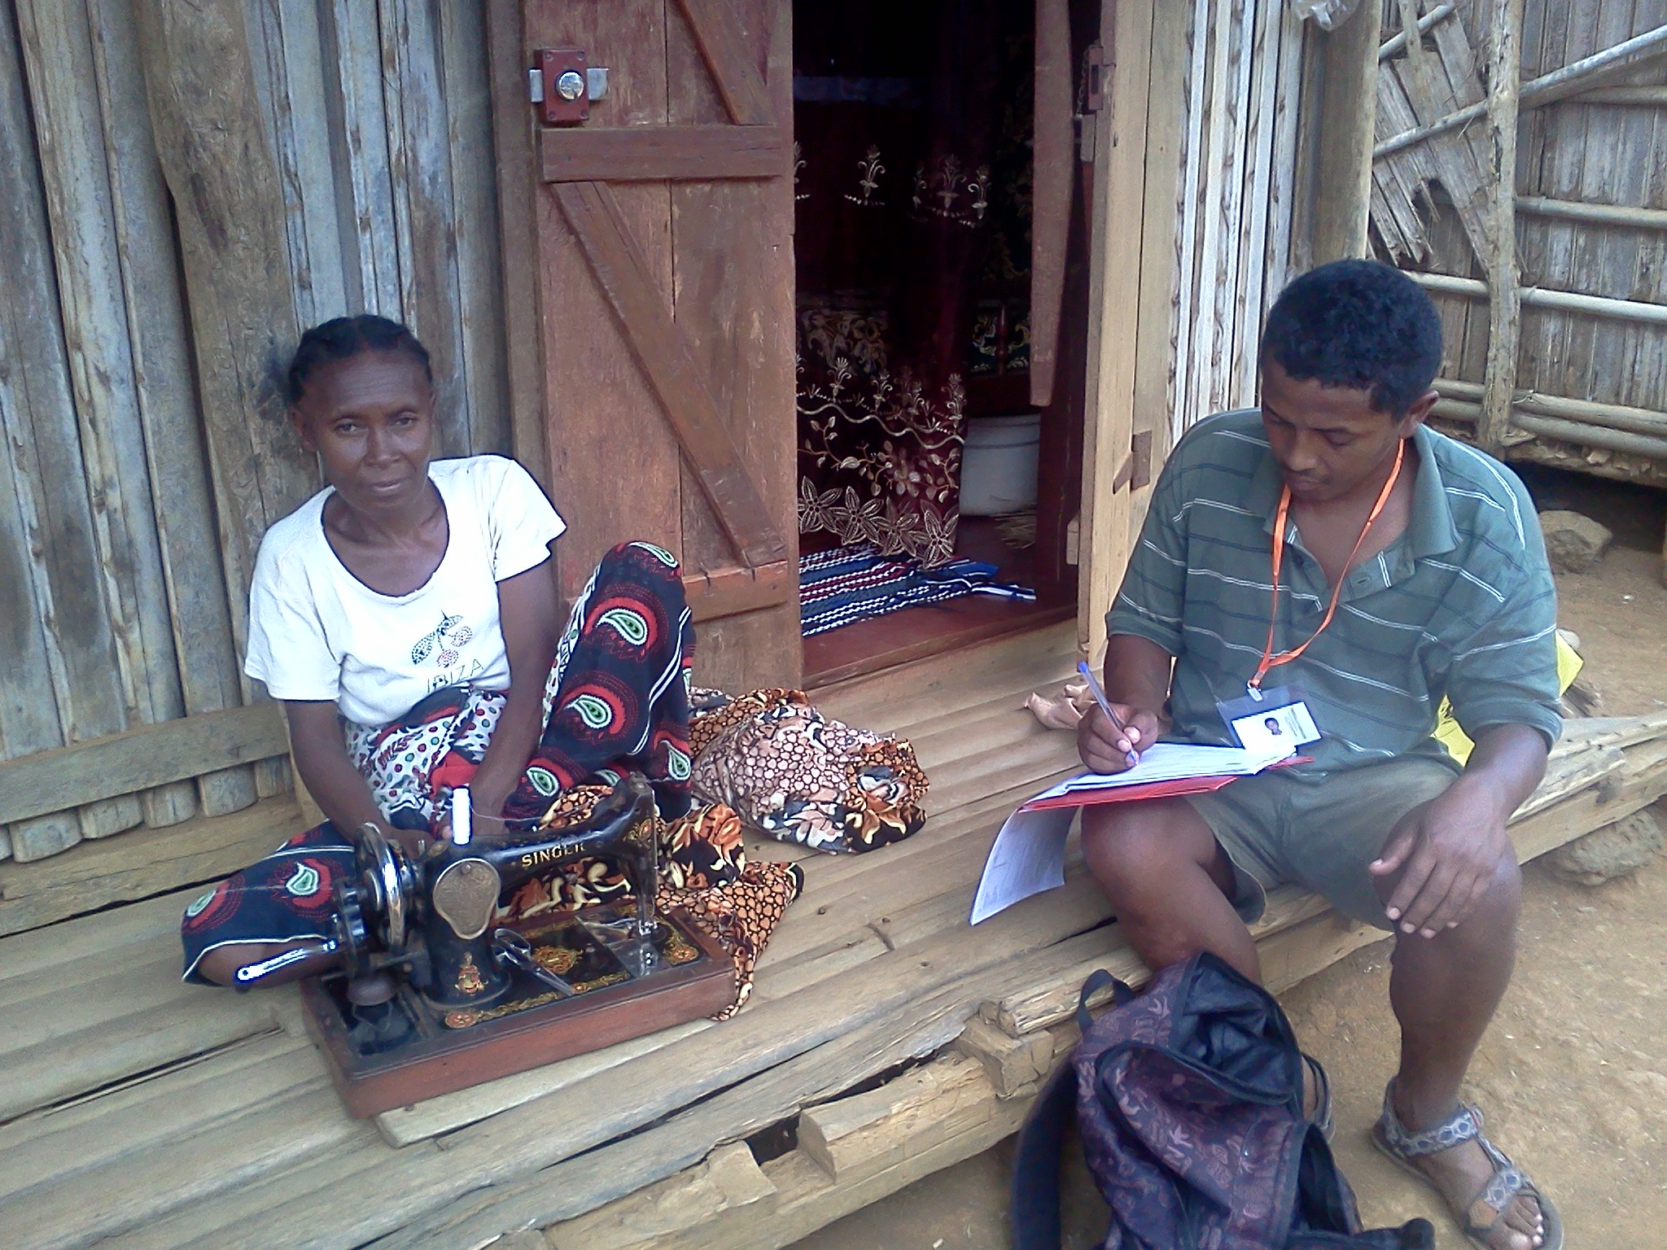
Copyright © 2014 Gallup, Inc. All rights reserved.
Notes:
Madagascar

Slide 9
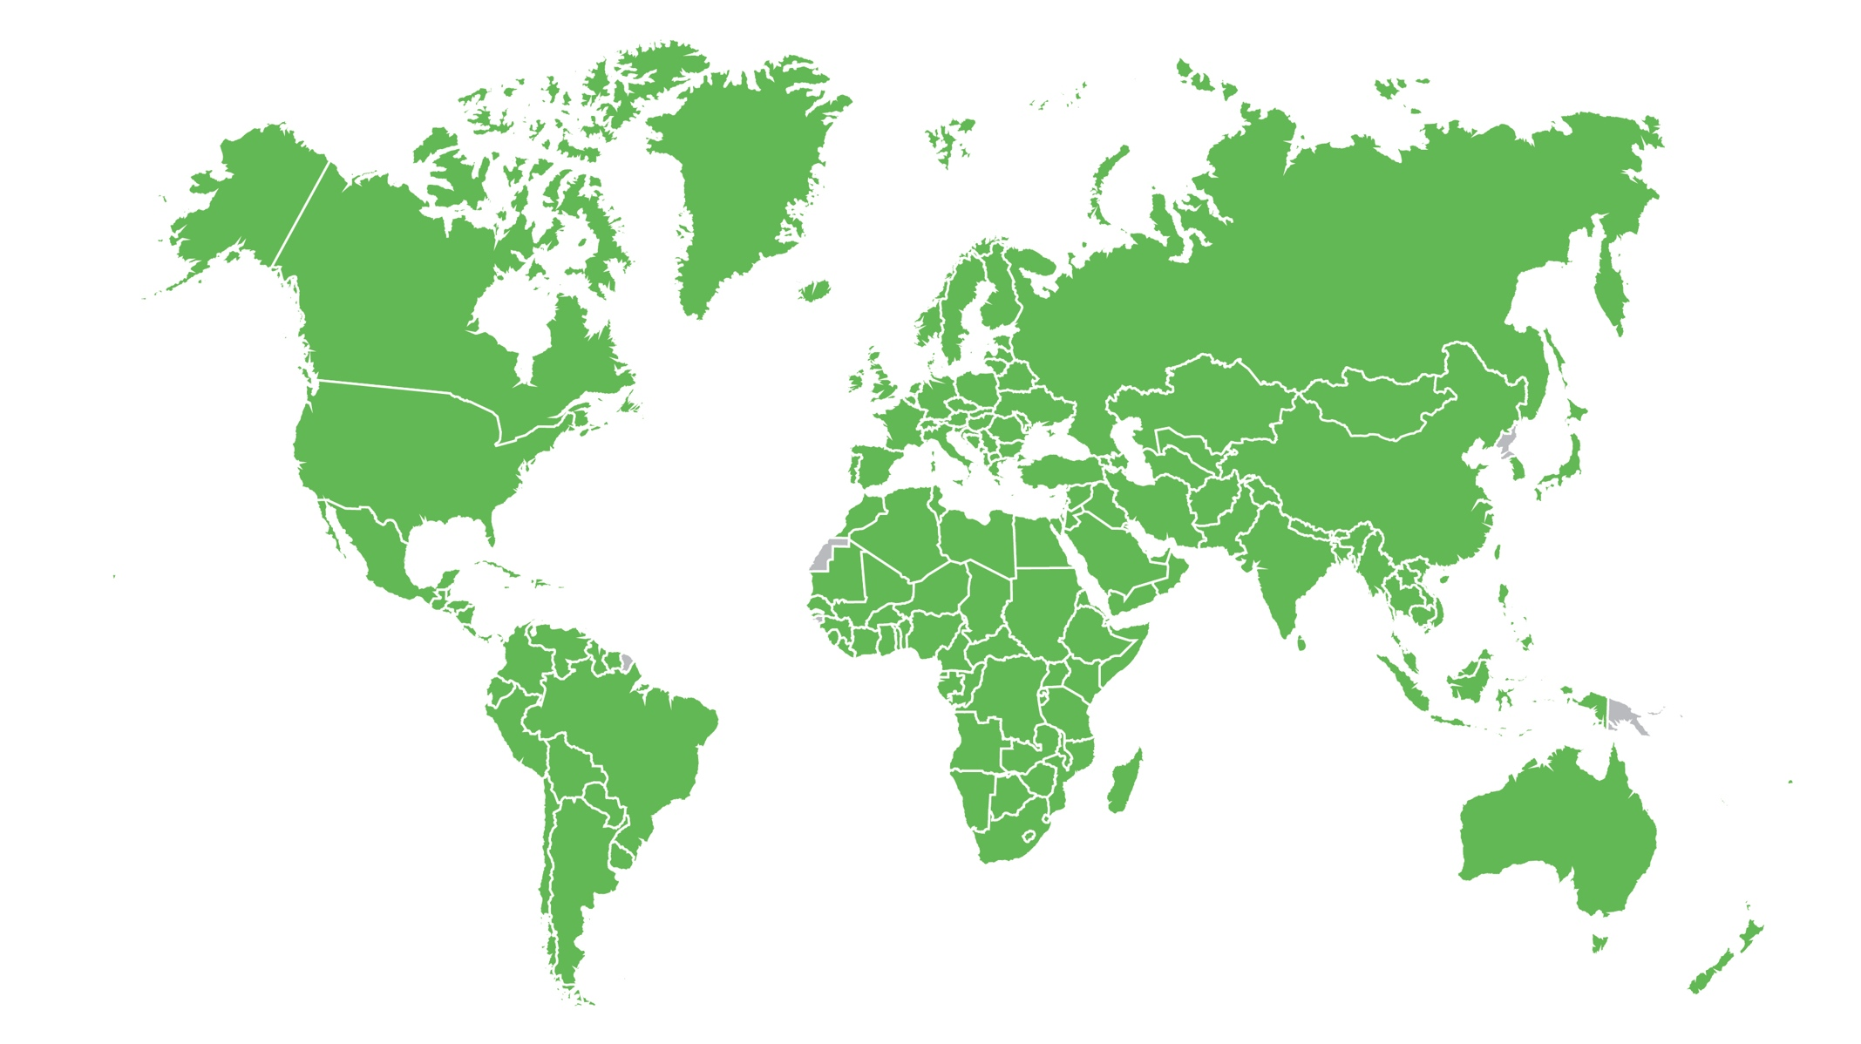

World Poll Countries
Copyright © 2014, 2015 Gallup, Inc. All rights reserved.

Slide 10
Ukraine GDP and Life Evaluations
*In current international dollars, estimates from IMF
Copyright © 2014, 2015 Gallup, Inc. All rights reserved.
Notes:
GDP per capita (PPP) data from IMF
http://www.imf.org/external/pubs/ft/weo/2014/01/weodata/index.aspx
Thriving data from Analytics (Life Evaluation Index, Thriving)
https://analytics.gallup.com/

Slide 11
Colombia GDP and Life Evaluations
*In current international dollars, estimates from IMF
Copyright © 2014, 2015 Gallup, Inc. All rights reserved.
Notes:
GDP per capita (PPP) data from IMF
http://www.imf.org/external/pubs/ft/weo/2014/01/weodata/index.aspx
Thriving data from Analytics (Life Evaluation Index, Thriving)
https://analytics.gallup.com/

Slide 12
South Africa GDP and Life Evaluations
*In current international dollars, estimates from IMF
Copyright © 2014, 2015 Gallup, Inc. All rights reserved.
Notes:
GDP per capita (PPP) data from IMF
http://www.imf.org/external/pubs/ft/weo/2014/01/weodata/index.aspx
Thriving data from Analytics (Life Evaluation Index, Thriving)
https://analytics.gallup.com/

Slide 13
USA GDP and Life Evaluations
*In current international dollars, estimates from IMF
Copyright © 2014, 2015 Gallup, Inc. All rights reserved.

Slide 14

TOGO GDP and Life Evaluations
*In current international dollars, estimates from IMF
Copyright © 2014, 2015 Gallup, Inc. All rights reserved.

Slide 15
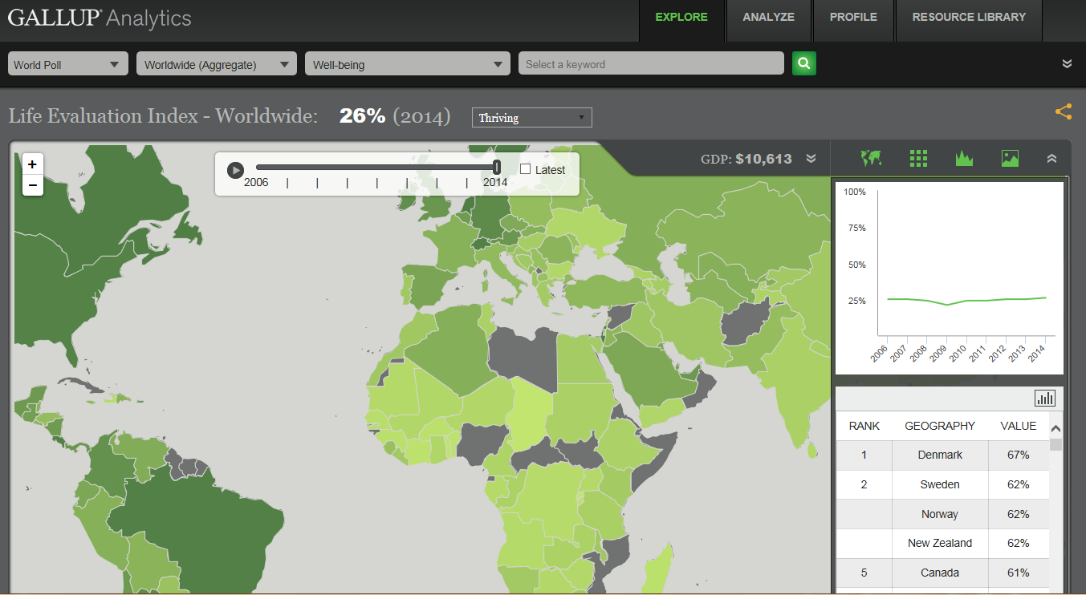
GaLLUP ANALYTICS analyze what the whole world is thinking
Copyright © 2014, 2015 Gallup, Inc. All rights reserved.

Slide 16
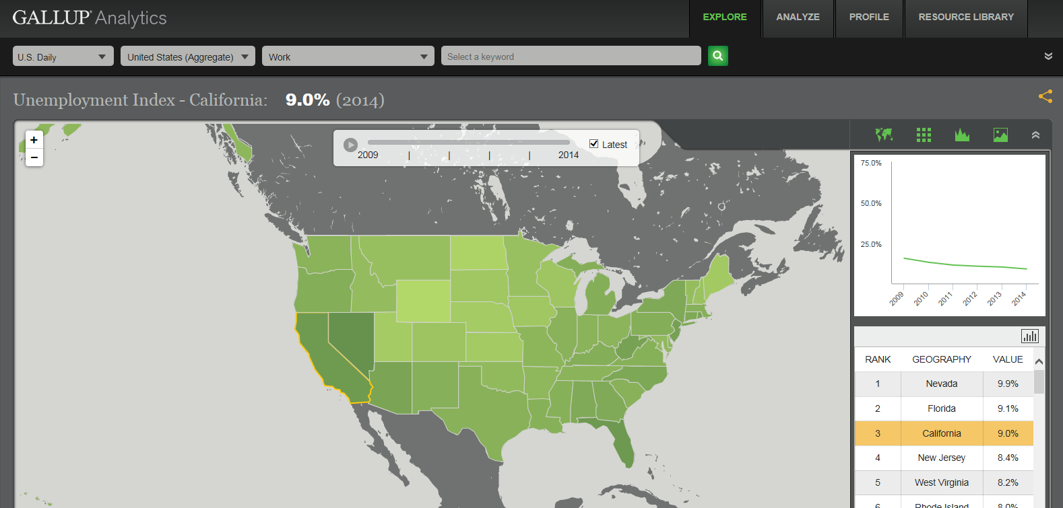
Analyze what America is thinking and doing everyday
Copyright © 2014, 2015 Gallup, Inc. All rights reserved.

Slide 17
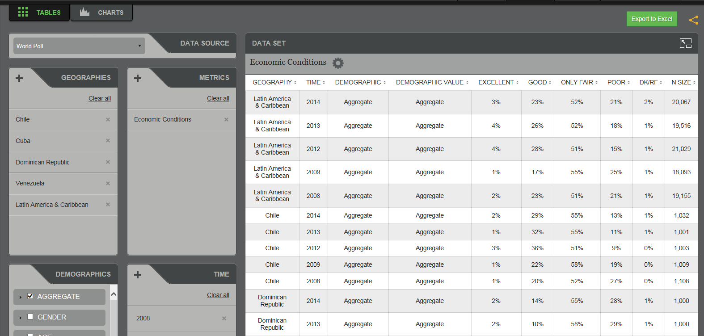
Create and export custom data tables, trends, charts, and scatter plots
Copyright © 2014, 2015 Gallup, Inc. All rights reserved.

Slide 18
Thank you
Jon Clifton
Managing Director
Gallup Global Analytics
Jon_Clifton@Gallup.com
Follow us @GallupAnalytics
Copyright © 2014, 2015 Gallup, Inc. All rights reserved.

Slide 19
Copyright Standards
This document contains proprietary research, copyrighted materials, and literary property of Gallup, Inc. It is for the guidance of your company only and is not to be copied, quoted, published, or divulged to others outside of your organization. Gallup® is a trademark of Gallup, Inc. All other trademarks are the property of their respective owners.
This document is of great value to both your organization and Gallup, Inc. Accordingly, international and domestic laws and penalties guaranteeing patent, copyright, trademark, and trade secret protection protect the ideas, concepts, and recommendations related within this document.
No changes may be made to this document without the express written permission of Gallup, Inc.
Copyright © 2014, 2015 Gallup, Inc. All rights reserved.

